Slide 1

Efficient Execution of Transformers in RISC-V Vector Machines with Custom HW Acceleration
Integrated Systems Laboratory
Students: Xiaorui Yin
Advisors: Matteo Perotti, Victor Jung, Renzo Andri
Prof. Dr. Luca Benini

Slide 2

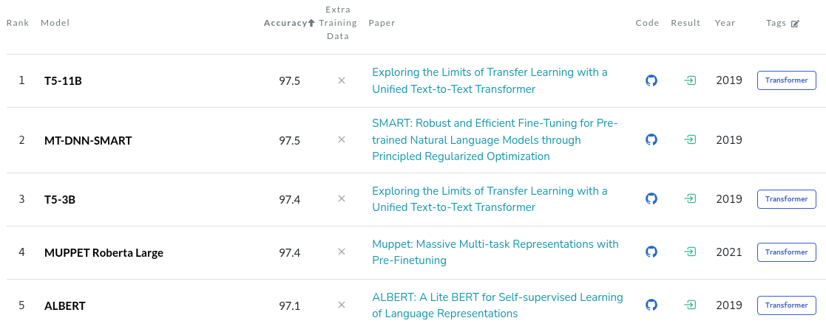

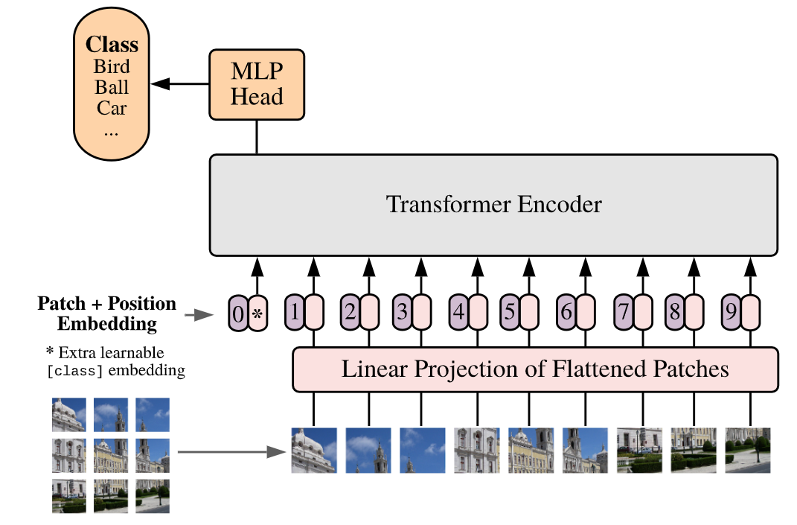
Transformer is Everywhere
1. From Natural Language Processing
2. To Images Processing
1. PaperWithCode 2. by Jim Clyde Monge (https://medium.com/geekculture/openai-released-chatgpt-an-incredibly-smart-chatbot-889b59968383)
3. 4. ViT paper
Notes:
简要介绍transformer的重要性，举例如ChatGPT

Slide 3
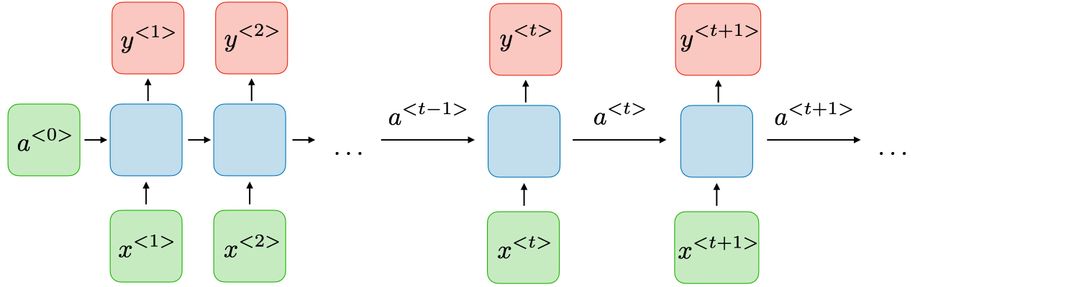
RNN vs Transformers
RNN: y<t> depends on a<0>, …, a<t-1>
Vanishing gradient (chain rule)
Example:
I am a student at ETH. (Cryptocurrency ?)
Struggle to extract long-term dependencies
Slow inference & training
Transformers: all tokens are equidistant
Parallel processing
Effectively handle long-term dependencies
Add positional encoding to the input tokens

Slide 4
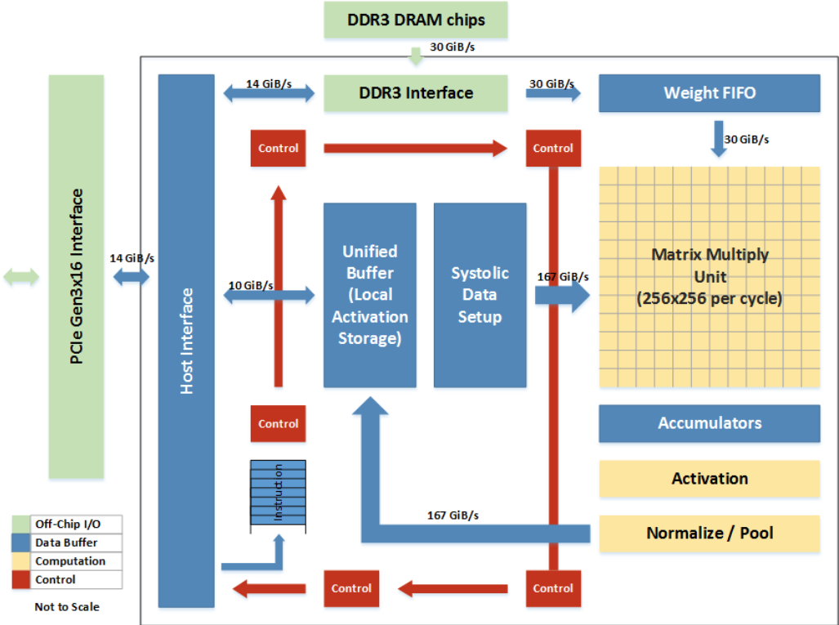
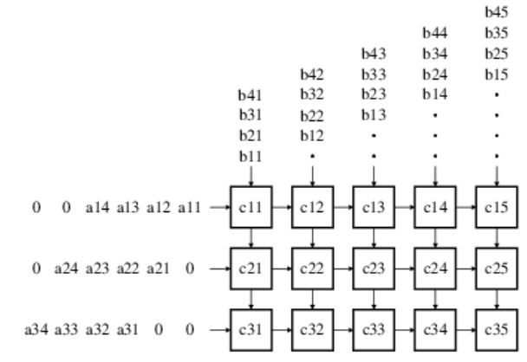
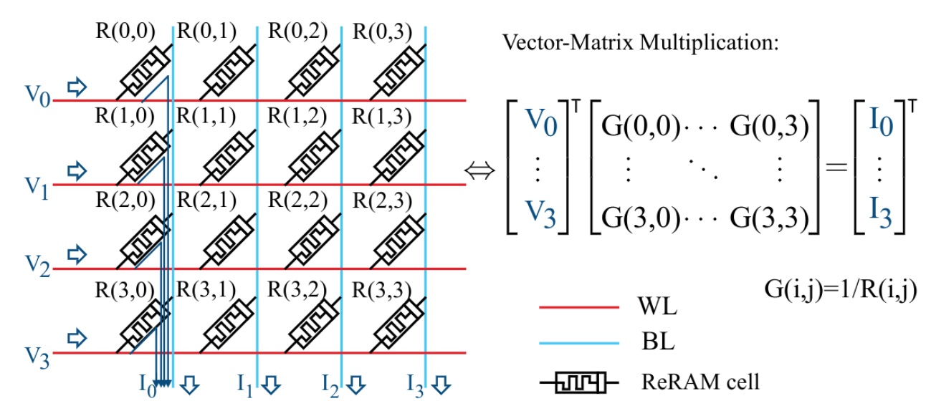
Transformer Accelerator
Specialized Accelerators
Best performance for a specific task/model
Lack of flexibility
DNNs evolve rapidly!!!
Vector Processor
General-purpose, easy programmable
Parallel computing, SIMD
Popular in supercomputing
Ara: RISC-V Vector Extension 1.0
Systolic Array
Reuse data across one row/column
Goal:
Explore the capabilities and challenges of vector processors in running the transformer model
Optimize performance from both hardware and software aspects
Memristor Crossbar Array
Kirchhoff’s Current Law
1. TPU 2. Chapter 16. Systolic Systems (https://gyires.inf.unideb.hu/KMITT/a52/ch04.html)
Notes:
Motivation：尽管有专用的加速器，但他们缺乏灵活性，我们想试试用通用处理器来加速transformer会有什么效果，困难，已经寻找可能的解决办法

Slide 5
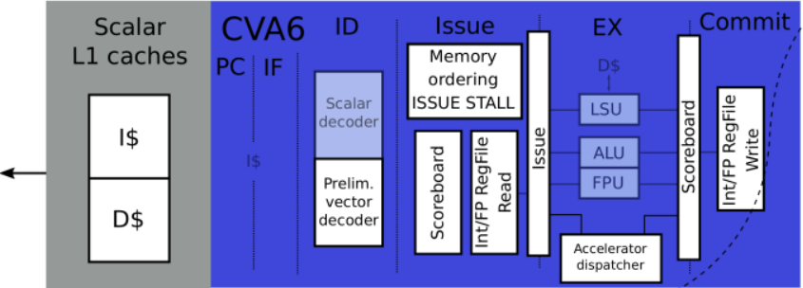
Vector Processor Ara
Scalar Core:
Send vector instructions to the vector unit
Notes:
一个简短的向量处理器以及Ara的介绍

Slide 6
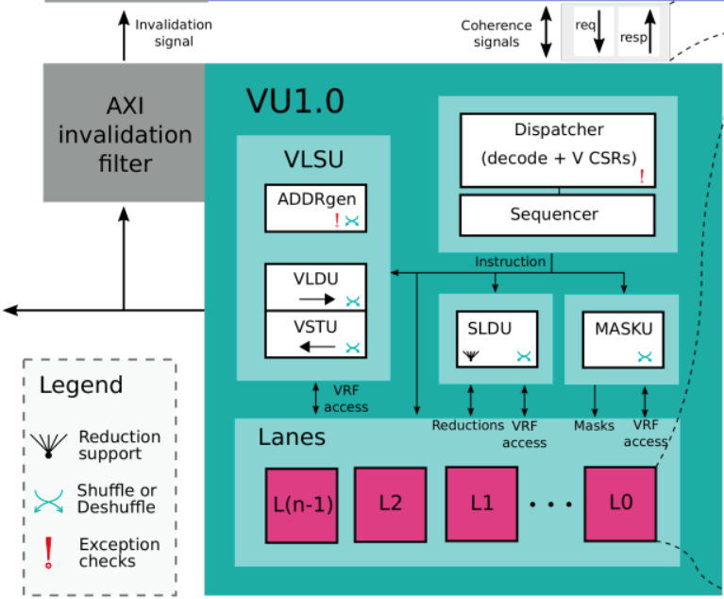
Vector Processor Ara
VLSU:
memory ←→VRF
Notes:
一个简短的向量处理器以及Ara的介绍

Slide 7
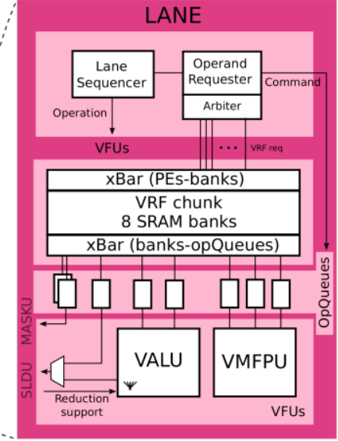
Vector Processor Ara
VRF:
Store a portion of the vector
Notes:
一个简短的向量处理器以及Ara的介绍

Slide 8
Vector Processor Ara
Integer and Floating-Point Processing Units
Notes:
一个简短的向量处理器以及Ara的介绍

Slide 9
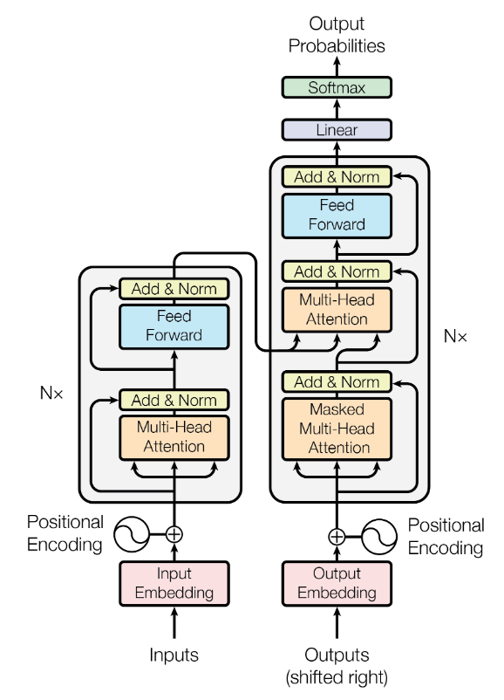
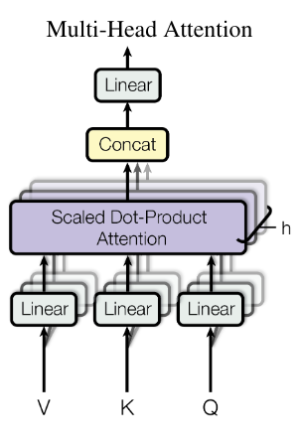
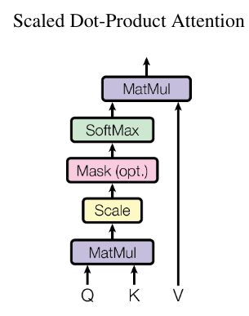
Transformer’s Architecture
Benchmark
Notes:
Transformer模型结构大致的介绍

Slide 10
Transformer Vectorization: Multihead Attention
weight matrices (d_model x d_model)
768x768
Q, K, V (n x d_model)
64x768
weight matrix (d_model x d_model)
768x768
Q
Wo
Wq
MatMul
Bias
h
Output to Feed Forward (n x d_model)
64x768
input tokens or output from the previous layer (n x d_model)
64x768
Self-Attention
Self-Attention
K^T
Self-Attention
MatMul
Bias
Residual
Wk
MatMul
Bias
Transpose
Self-Attention
Dropout
LayerNorm
y
x
n * d_model * d_model MAC
2 * n * d_model ADD
MatMul
Bias
Wv
V
Dropout: n * d_model Op
LayerNorm: 7 * n * d_model + 4 * n Op
n * d_model * d_model MAC
n * d_model ADD
Q(i)
S (n x n)
64x64
MatMul
Softmax
S
self-attention (n x dk)
64x64
Q, K, V (n x dk)
64x64
n * dk * n MAC
n * n * 91 Op
K(i)^T
MatMul
SA(i)
V(i)
n * n* dk MAC

Slide 11
Transformer Vectorization: Multihead Attention
weight matrix (d_model x d_model)
768x768
Wo
h
Output to Feed Forward (n x d_model)
64x768
Multicore System:
Split Wq/Wk/Wv
Calculate Q(i), K(i), V(i) of each head individually
Self-Attention
Self-Attention
Self-Attention
MatMul
Bias
Residual
Self-Attention
Dropout
LayerNorm
y
d_model 768
Wq
Wq(0)
Wq(1)
Wq(2)
Wq(3)
n * d_model * d_model MAC
2 * n * d_model ADD
d_model
768
…
Dropout: n * d_model Op
LayerNorm: 7 * n * d_model + 4 * n Op
dk 64
Q(i), K(i), V(i) (n x dk)
64x64
weight matrices (d_model x dk)
768x64
MatMul
Bias
Q(i)
S (n x n)
64x64
MatMul
Softmax
S
input tokens or output from the previous layer (n x d_model)
64x768
Wq(i)
MatMul
Bias
Transpose
self-attention (n x dk)
64x64
n * dk * n MAC
n * n * 91 Op
x
K(i)^T
MatMul
SA(i)
Wk(i)
n * d_model * dk MAC
n * dk ADD
MatMul
Bias
V(i)
n * n* dk MAC
Wv(i)

Slide 12
Transformer Vectorization: Feed Forward
Weight matrix 1 (d_model x d_ff)
768x3072
Weight matrix 2 (d_ff x d_model)
3072x768
W1
W2
Temp matrix (n x d_ff)
64x3072
Output to the next block (n x d_model)
64x768
MatMul
Bias
y’
MatMul
Bias
Residual
ReLU
Dropout
LayerNorm
O
output of Multihead Attention (n x d_model)
64x768
n * d_model * d_ff MAC
n * d_ff ADD
n * d_ff Op
n * d_model * d_ff MAC
2 * n * d_model ADD
Dropout: n * d_model Op
LayerNorm: 7 * n * d_model + 4 * n Op
y

Slide 13
Transformer Vectorization: Individual Kernels
Dropout & ReLU:
x = 0 if x < 0 or based on a probability (mask)
VL_app = row * col
Softmax & LayerNorm:
Elements in a row are dependent
Load column for parallelization (strided load/store)
VL_app = row

Slide 14
Runtime Distribution
Transformer
Multihead Attention
Feed Forward
35.5%
64.5%
63,176,959 clock cycles
MatMul
Self-Attention x 12
MatMul
Multihead Attention
Feed Forward
89.6%
8.0%
98.4%
LayerNorm+Dropout 2.4%
LayerNorm+ReLU+Dropout 1.6%
MatMul > 95%
MatMul
Softmax
Self-Attention
60%
40%

Slide 15
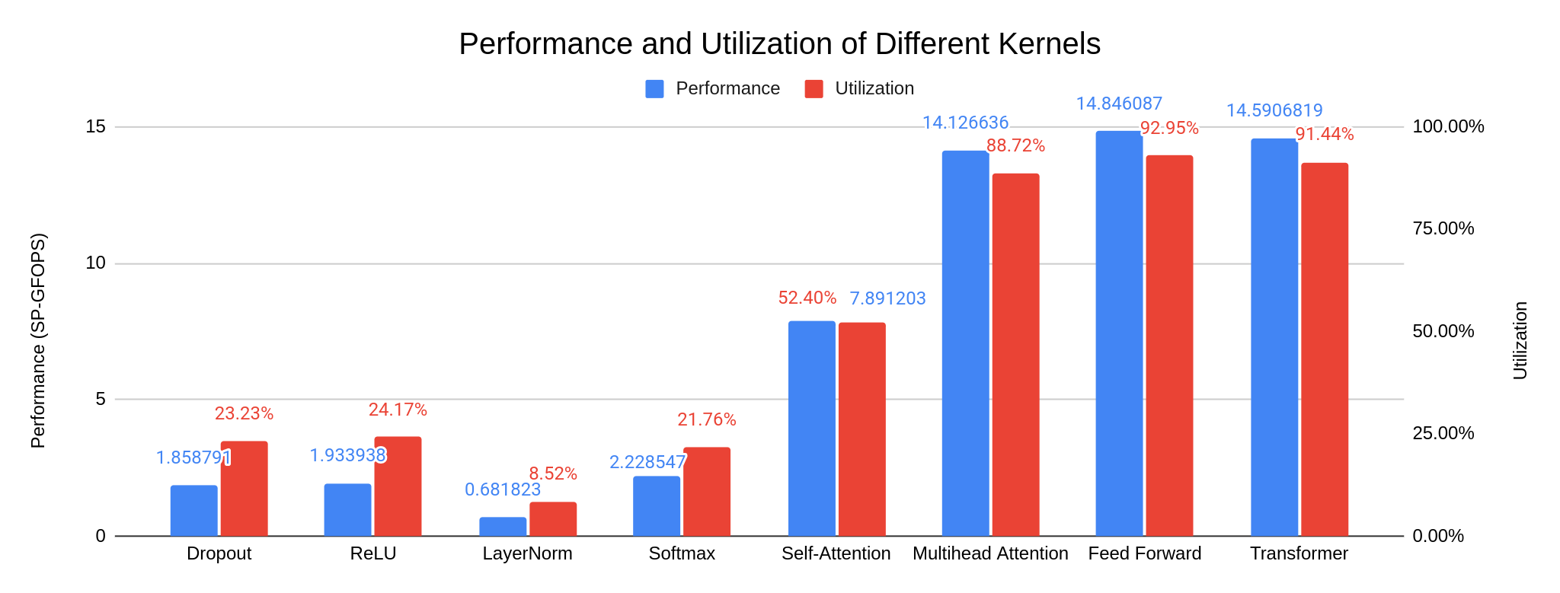
Simulation Result 1

Slide 16
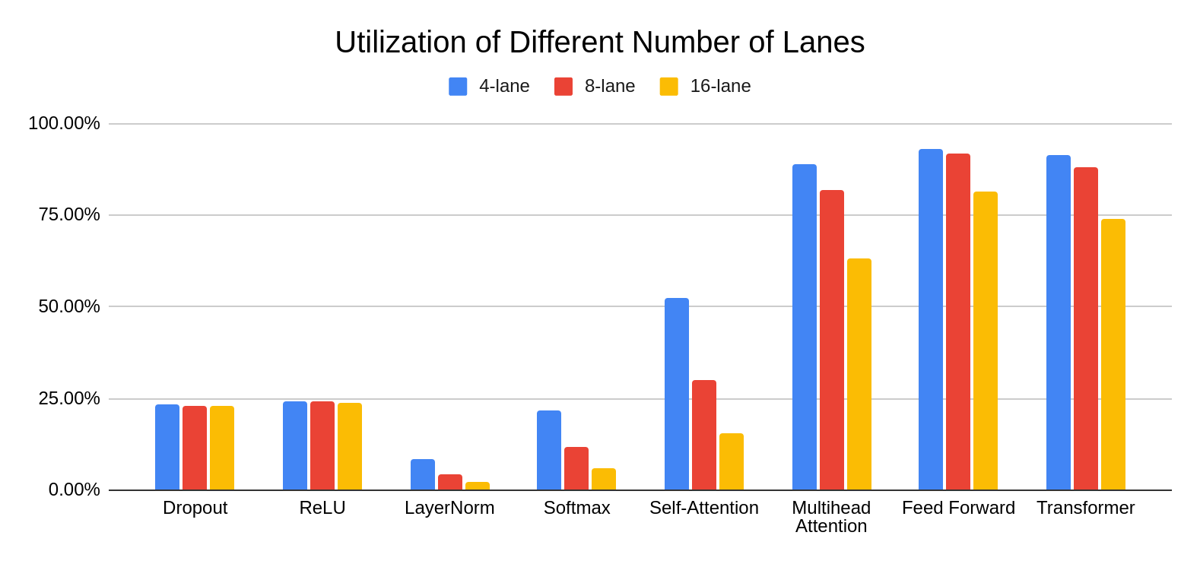
Simulation Result 2
limited by strided ld/st
inefficient small MatMul

Slide 17
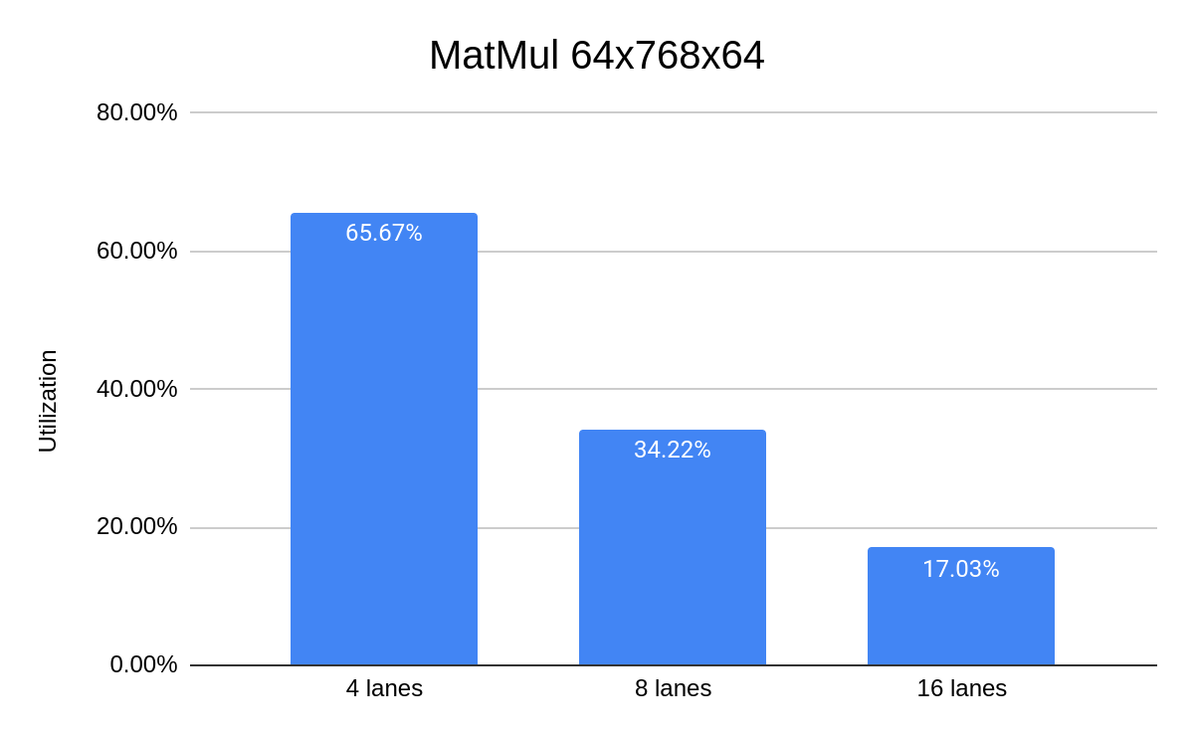
Individual calculation of Q/K/V
vl=64, too short to utilize the hardware

Slide 18
Optimization 1: Improved MatMul with Reduced VL Sensitivity
vl
Vanilla MatMul:
vl depends on P
nr_lanes ↑ nr_elements in each lane ↓
a00
b_vec 0
vreg1
a10
vreg2
a20
X
vreg3
a30
vreg4
Matrix A
MxN
Matrix B
NxP
Matrix C
MxP
Improved MatMul:
Broadcast b_vec to all lanes
Each lane gets sufficient elements
Load A into VRF
bl (max 32 for fp32)
b_vec 0
vl = nr_lanes * reuse_size
a_vec
X
Notes:
A new way of executing the MatMul

Slide 19
1. Load a_vec to VRF
vl = reuse_size * nr_lanes
Each lane allocates reuse_size(=2) elements
lane 0
lane 1
lane 2
lane 3
a0, a4
a1, a5
a2, a6
a3, a7

Slide 20
2. Load b_vec to bc_buffer
New instructions: vsetbl, vlebc
lane 0
lane 1
lane 2
lane 3
a0, a4
a1, a5
a2, a6
a3, a7
bc_buffer
b_vec

Slide 21
3. Broadcast elements in b_vec to all lanes
lane 0
lane 1
lane 2
lane 3
a0, a4
a1, a5
a2, a6
a3, a7
bc_buffer
b_vec
X Backend can be problematic, hard to scale

Slide 22
3. Send elements in b_vec to the first lane
lane 0
lane 1
lane 2
lane 3
a0, a4
a1, a5
a2, a6
a3, a7
bc_buffer
1 clock cycle
b_vec
broadcast path

Slide 23
4. Multiply a with b_vec
New instruction: vfbmacc (include step 3)
lane 0
lane 1
lane 2
lane 3
a0, a4
a1, a5
a2, a6
a3, a7
bc_buffer
a0 * [b_vec] + ac →vreg0
a1 * [b_vec] + ac →vreg0
a2 * [b_vec] + ac →vreg0
a3 * [b_vec] + ac →vreg0
b_vec
a4 * [b_vec] + ac →vreg1
a5 * [b_vec] + ac →vreg1
a6 * [b_vec] + ac →vreg1
a7 * [b_vec] + ac →vreg1
vreg0/1: bl elements in each lane → vl = bl * nr_lanes

Slide 24
5. Store results in memory
New instruction: vssebc
lane 0
lane 1
lane 2
lane 3
vreg0 vreg1
vreg0 vreg1
vreg0 vreg1
vreg0 vreg1
VSTU
More efficient if storing the transposed matrix
Support of new instructions:
LLVM Compiler
Spike ISA simulator
Memory

Slide 25
Optimization 2: Transpose the Transformer
Improved MatMul works better with transposed matrix
Softmax LayerNorm
columns → rows (contiguous address)
unit-stride memory ld/st (burst mode)
No negative effect on other kernels
Self-Attention
V(i)^T
Linear Algebra:
SA = S x V
V^T x S^T = SA^T
Q(i)^T
MatMul_t
SA(i)
MatMul_t_at
Softmax
S^T
K(i)^T
Matrix A is transposed (Q(i)^T)

Slide 26
Hardware: Broadcast Buffer
bc_buffer
invalidate when finish
FIFO 0
read
Lane 0
vldu
write
FIFO 1
2 * 32 * 32 bits
Notes:
hardware support 1: bc_buffer

Slide 27
Hardware: Broadcast Buffer
bc_buffer
FIFO 0
Lane 0
write
read
vldu
FIFO 1
2 * 32 * 32 bits
Notes:
hardware support 1: bc_buffer

Slide 28
Hardware: Broadcast Operand Queue
Lane 1
Lane 2
Broadcast Data
depth=2
lane-lane delay
depth=2
FIFO
FIFO
FPU delay
FPU
FPU
Notes:
hardware support 2: broadcast path

Slide 29
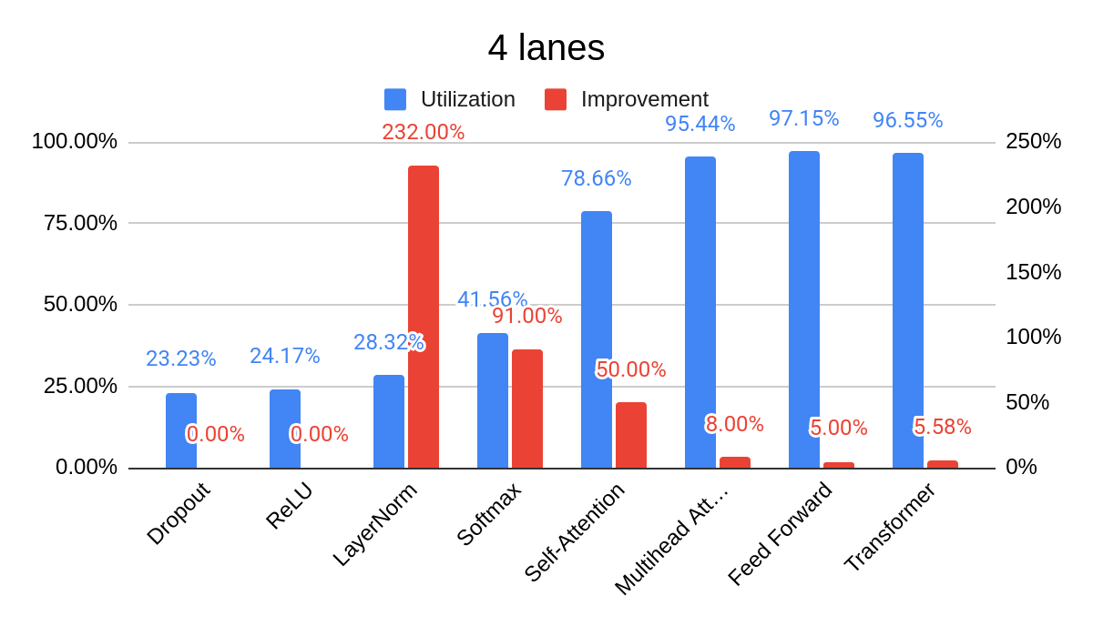
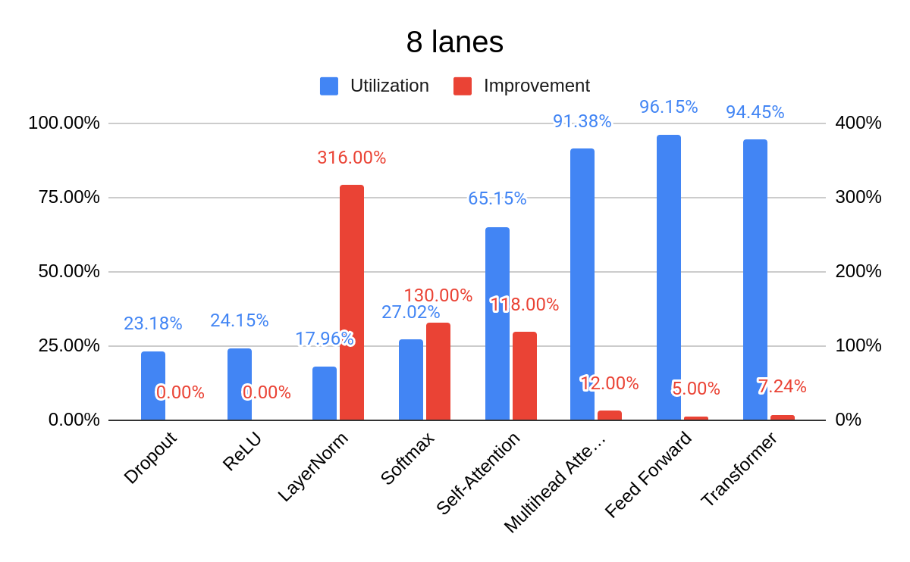
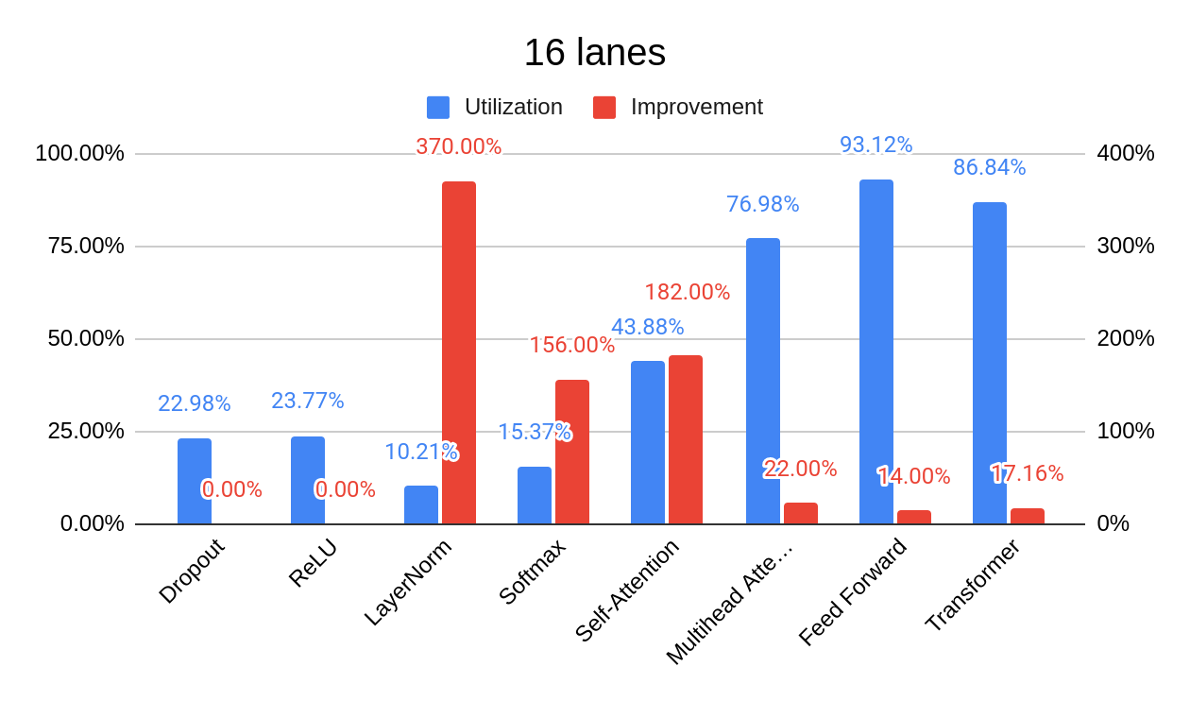
Performance Improvement: Transformer
Notes:
Performance Improvement 1 Each kernel
MatMul

Slide 30
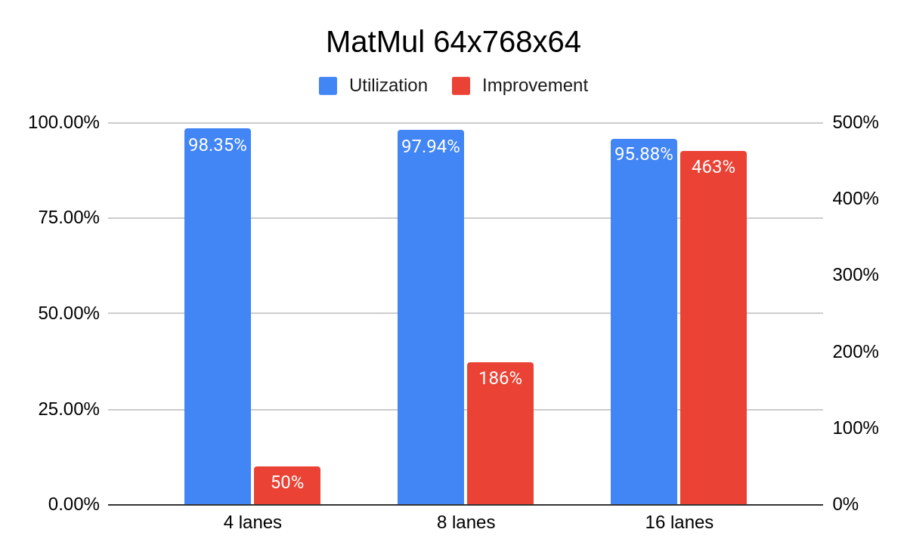
Performance Improvement: Transformer (Multicore)
Estimated improvement for the transformer: 17% 49% 125%
Notes:
Performance Improvement 2 QKV

Slide 31
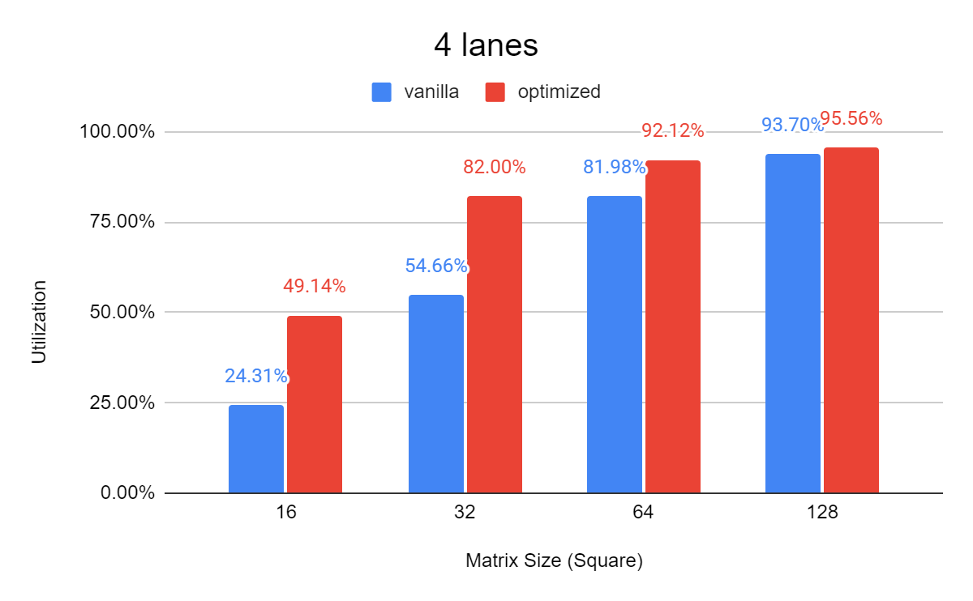
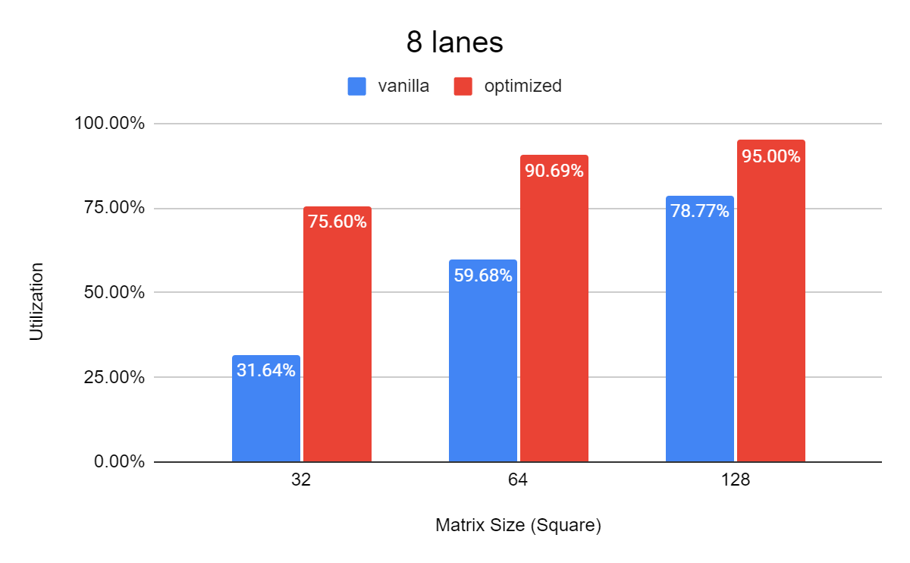
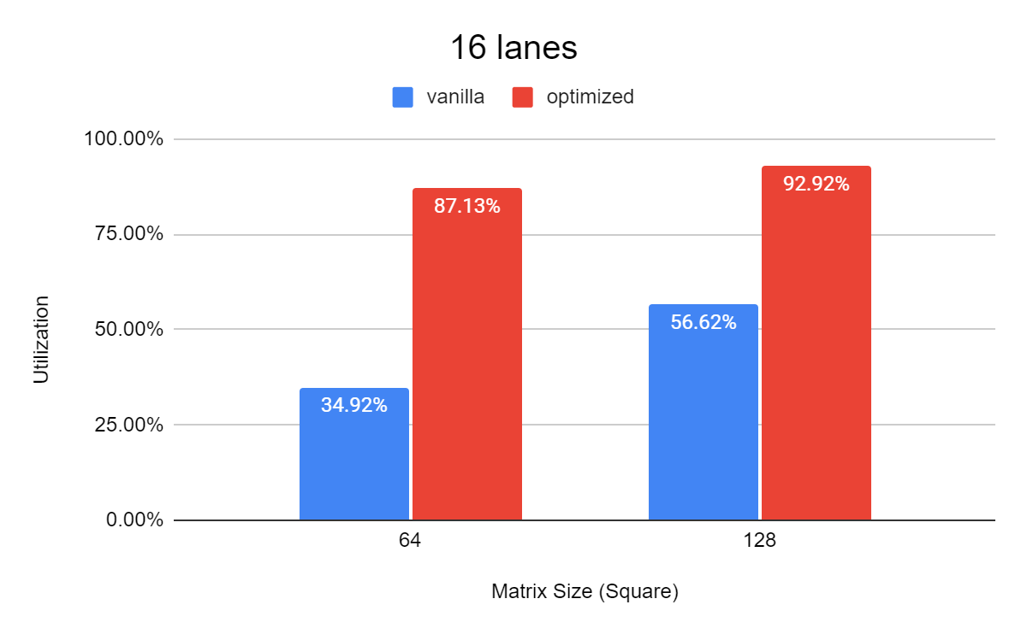
Performance Improvement: Small MatMul
Currently does not support arbitrary dimensions
2x
2.4x
2.5x

Slide 32
Physical Design (GlobalFoundries 22FDX FD-SOI, 1GHz)
Flat mode
Implement system and lanes together → slower but better result
Non-flat mode: implement lane first, then integrate it to the system
Floorplan optimization
BC_BUFFER
BC_BUFFER
L2
L3
L0
L3
L0
L1
L1
L2
Critical path
Notes:
Floorplan optimization, flat mode

Slide 33
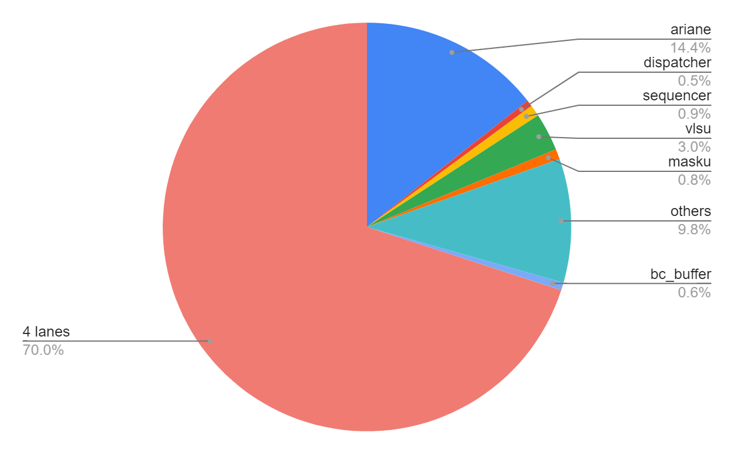
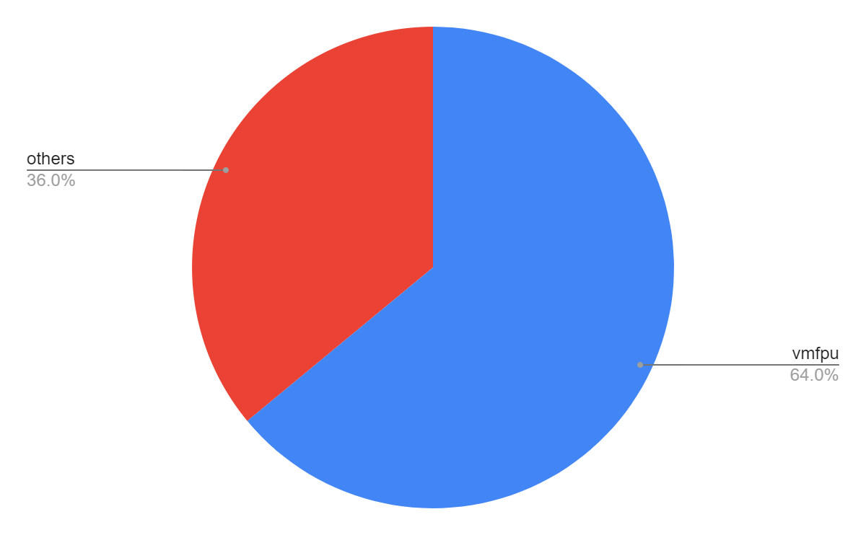
Power Results
Estimate the transformer power by a small segment of MatMul (64x768x768)
Represent > 95%
 | int (mW) | switch (mW) | leak (mW) | total (mW) | GFLOPS/W
Vanilla | 120 | 72.2 | 1.0 | 202 | 74.45
Optimized | 110 | 73.1 | 1.1 | 198 | 78.38
5.27%
Notes:
Power Estimation Transformer FLOPS/W different MatMul

Slide 34
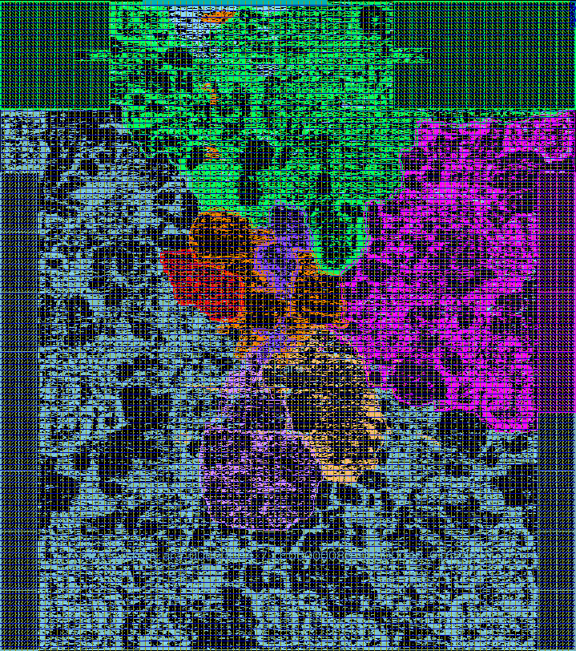
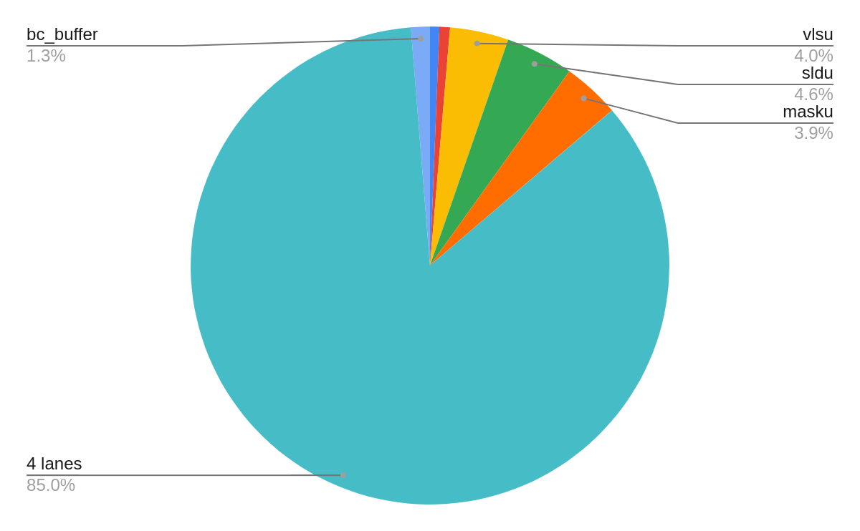
Backend Result
Timing:
TC: no violations, 1GHz
WC: vanilla -34ps(967MHz), modified -53.43ps(949MHz)
ariane
ariane
Area:
Cell area utilization: 79.10% → 82.49% (3.39% ↑)
dispatcher
sequencer
bc_buffer
lane 3
lane 0
vlsu
masku
sldu
vector unit 100%
Notes:
Backend TC: 1GHz, WC: Area

Slide 35
Conclusion
Implemented transformers on general-purpose vector processor Ara
Optimized based on the performance analysis
Short vl MatMul in self-attention & multicore
→ An improved Matmul (custom instructions, hardware, compiler, ISA sim)
Low utilization of Softmax & LayerNorm
→ Transposed matrix
Transformer speed-up 17% (16-lanes)
LayerNorm: 370%
Multicore: 125%
Small MatMul: up to 2.5x higher in utilization
Less power consumption (4mW less)
Notes:
Conclusion Future Work

Slide 36
Future Work
New MatMul
Transformer
Support for arbitrary matrix sizes
Further improve utilization
Other applications: CNN …
Deploy a more appropriate model
Explore sparsity, low-precision

Slide 37
END

Slide 38
Vector Processor Ara
Dispatcher & Sequencer:
Decoding, CSRs, Hazard, Issue
Notes:
一个简短的向量处理器以及Ara的介绍

Slide 39
Vector Processor Ara
SLDU & MASKU:
vector permutation & mask manipulation
Notes:
一个简短的向量处理器以及Ara的介绍

